Slide 1

K-means Clustering

Slide 2
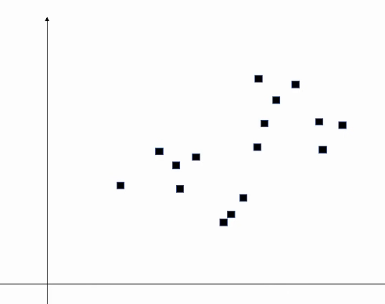
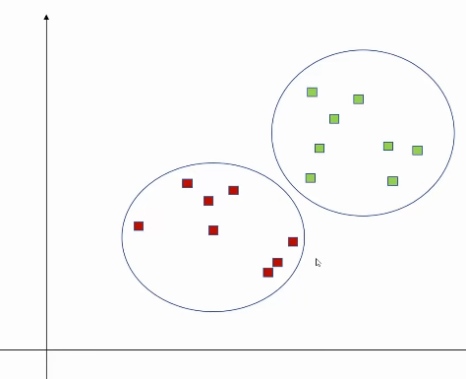
CLUSTER
Clustering is the classification of objects into different groups, or more precisely, the partitioning of a data set into subsets (clusters), so that the data in each subset (ideally) share some common trait - often according to some defined distance measure.
K denotes number of clusters in K-means clustering.

Slide 3
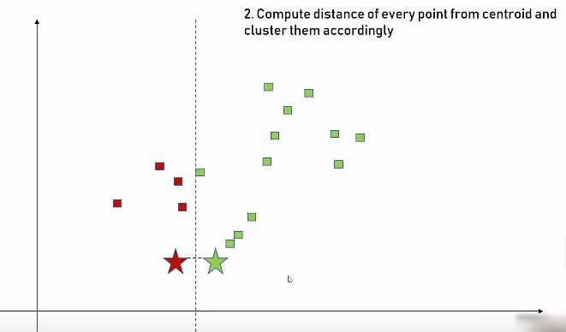
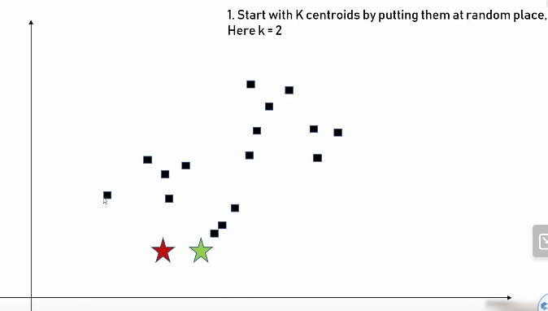
CLUSTERING STEPS

Slide 4
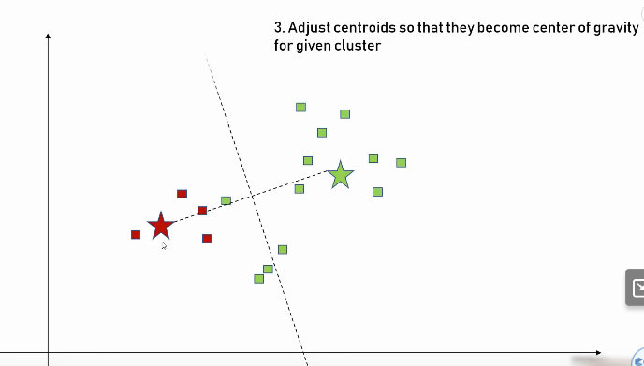
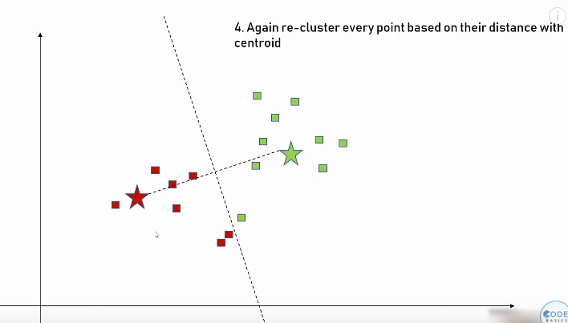
CLUSTERING STEPS

Slide 5
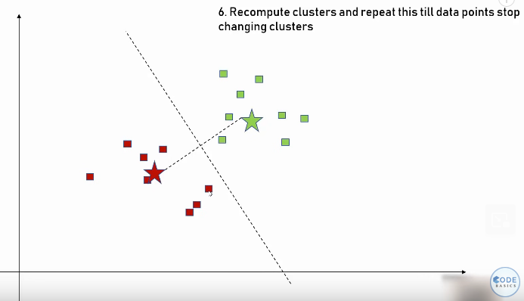
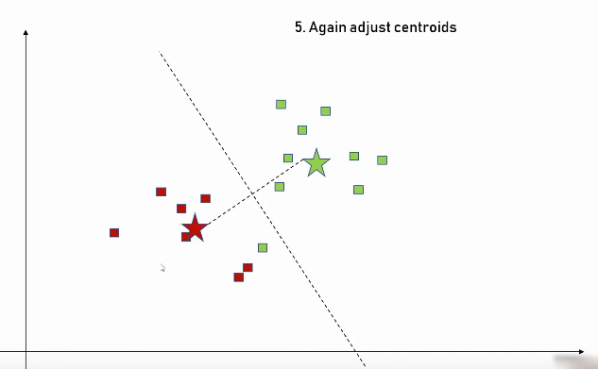
CLUSTERING STEPS

Slide 6
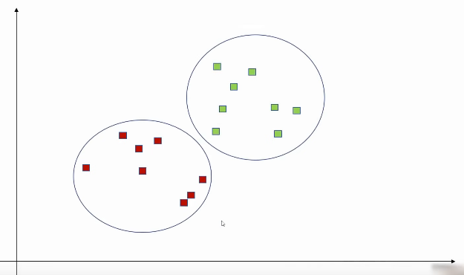
FINAL CLUSTERS

Slide 7
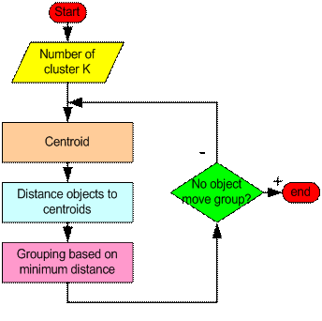
How the K-Mean Clustering algorithm works?

Slide 8
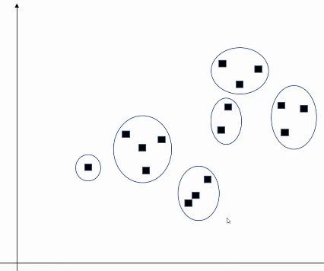
How to determine correct K?

Slide 9
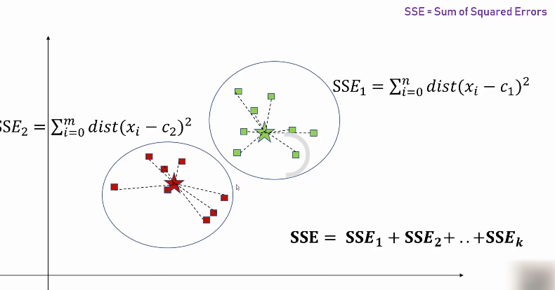
Elbow Method

Slide 10
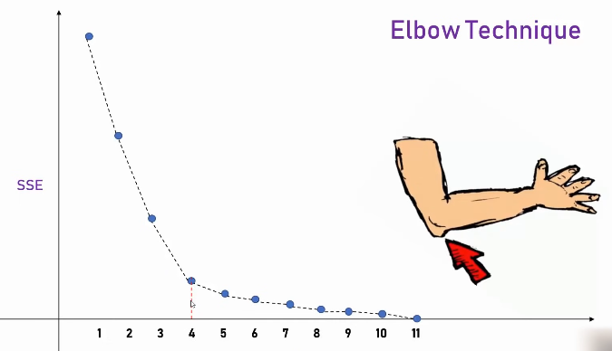

Slide 11
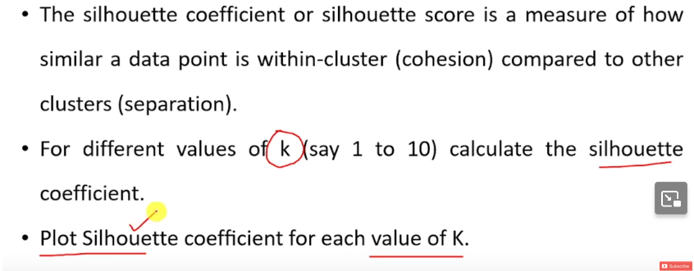
Silhouette Method

Slide 12
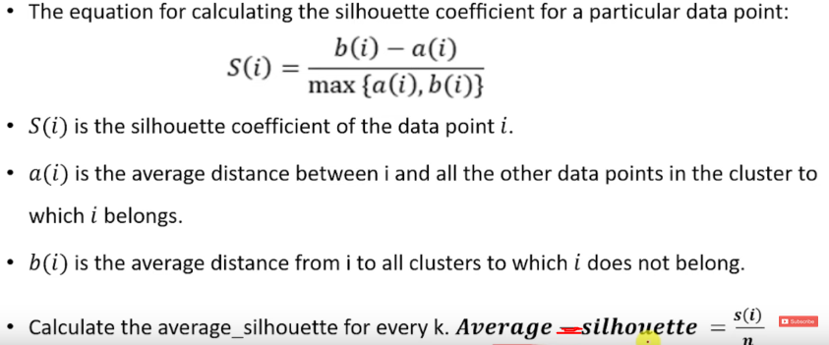
Silhouette Method

Slide 13
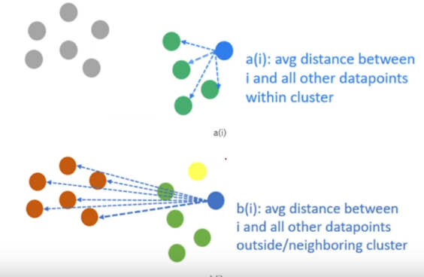
Silhouette Method

Slide 14
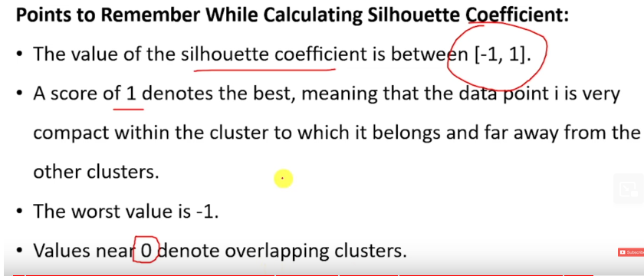
Silhouette Method

Slide 15
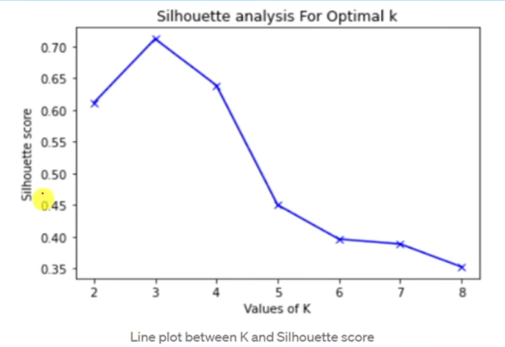
Silhouette Method

Slide 16



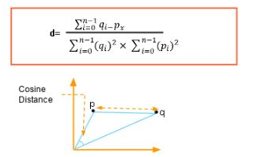
Distance Measure
Euclidean distance measure
A squared Euclidean distance measure
Manhattan distance measure
Cosine distance measure

Slide 17
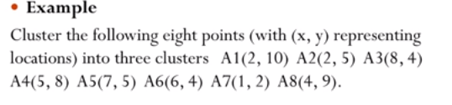
K-means Algorithm (using K=3) (Example1)

Slide 18
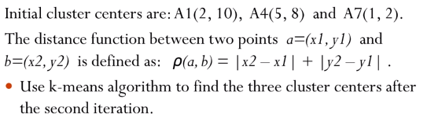
Solution

Slide 19
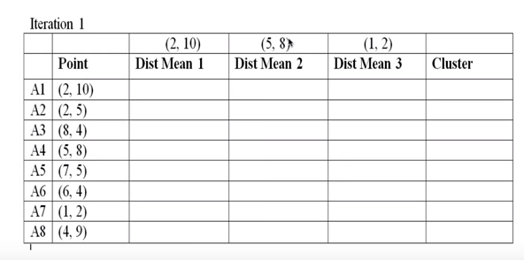
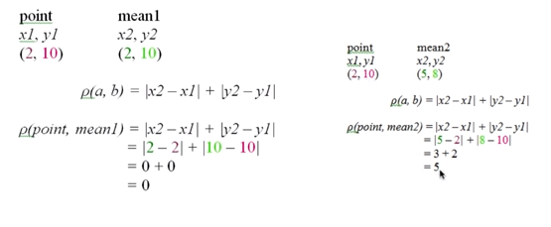
Example continued

Slide 20
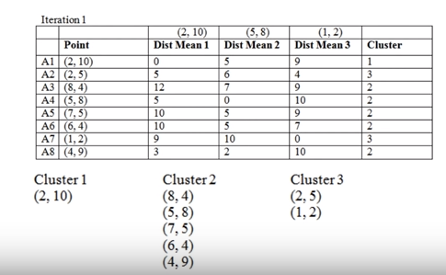
Example continued
Assign cluster for minimum distance.
Min(0,5,9) = 0
Cluster 1

Slide 21
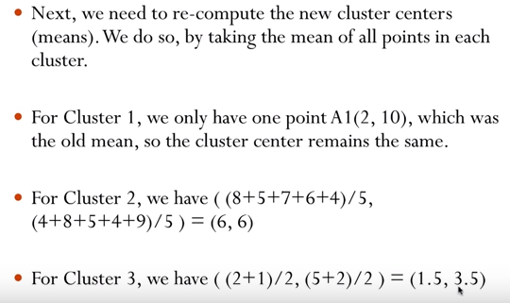
Example continued

Slide 22
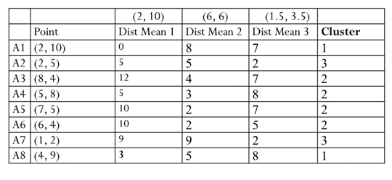
Example continued

Slide 23
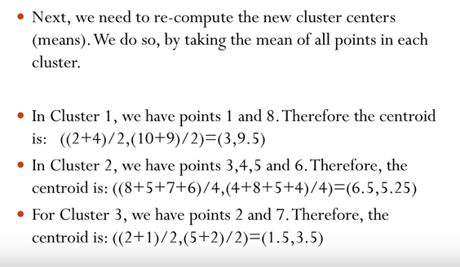
Example continued

Slide 24
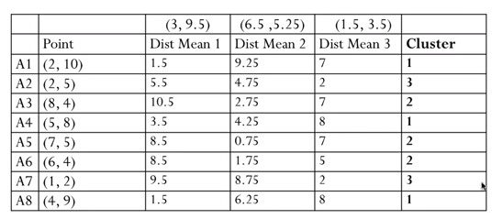
Example continued

Slide 25
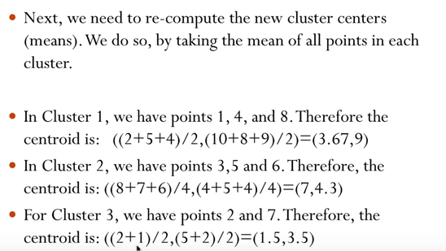
Example continued

Slide 26
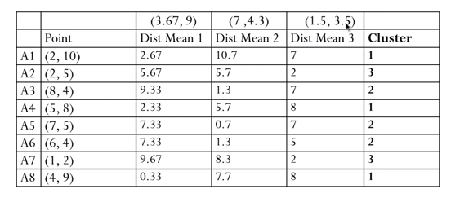
Example continued

Slide 27
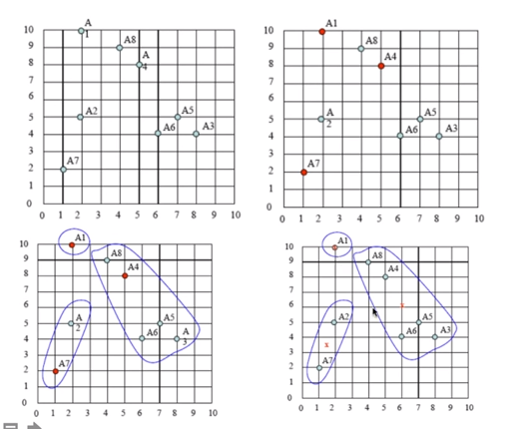
Example continued(Plot)

Slide 28
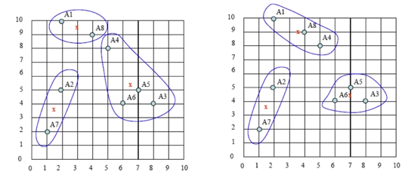
Example continued(Plot)

Slide 29
Advantages
Easy to Use
High Performance
Unlabeled Data
Result Interpretation
Scales to large data sets.
Easily adapts to new examples.

Slide 30
Disadvantages
Choosing (k) manually
Being dependent on initial values
Clustering outliers
Scaling with number of dimensions
Inability to Handle Categorical Data

Slide 31
Applications
Academic performance
Diagnostic systems
Search engines
Wireless sensor networks

Slide 32

Reference
https://www.youtube.com/watch?v=EItlUEPCIzM&list=PLeo1K3hjS3uvCeTYTeyfe0-rN5r8zn9rw&index=14
https://www.simplilearn.com/tutorials/machine-learning-tutorial/k-means-clustering-algorithm#applications_of_kmeans_clustering
https://www.youtube.com/watch?v=wW1tgWtkj4I
https://www.javatpoint.com/k-means-clustering-algorithm-in-machine-learning

Slide 33
Thank You

